Slide 1
The Problem of Evil

Slide 2
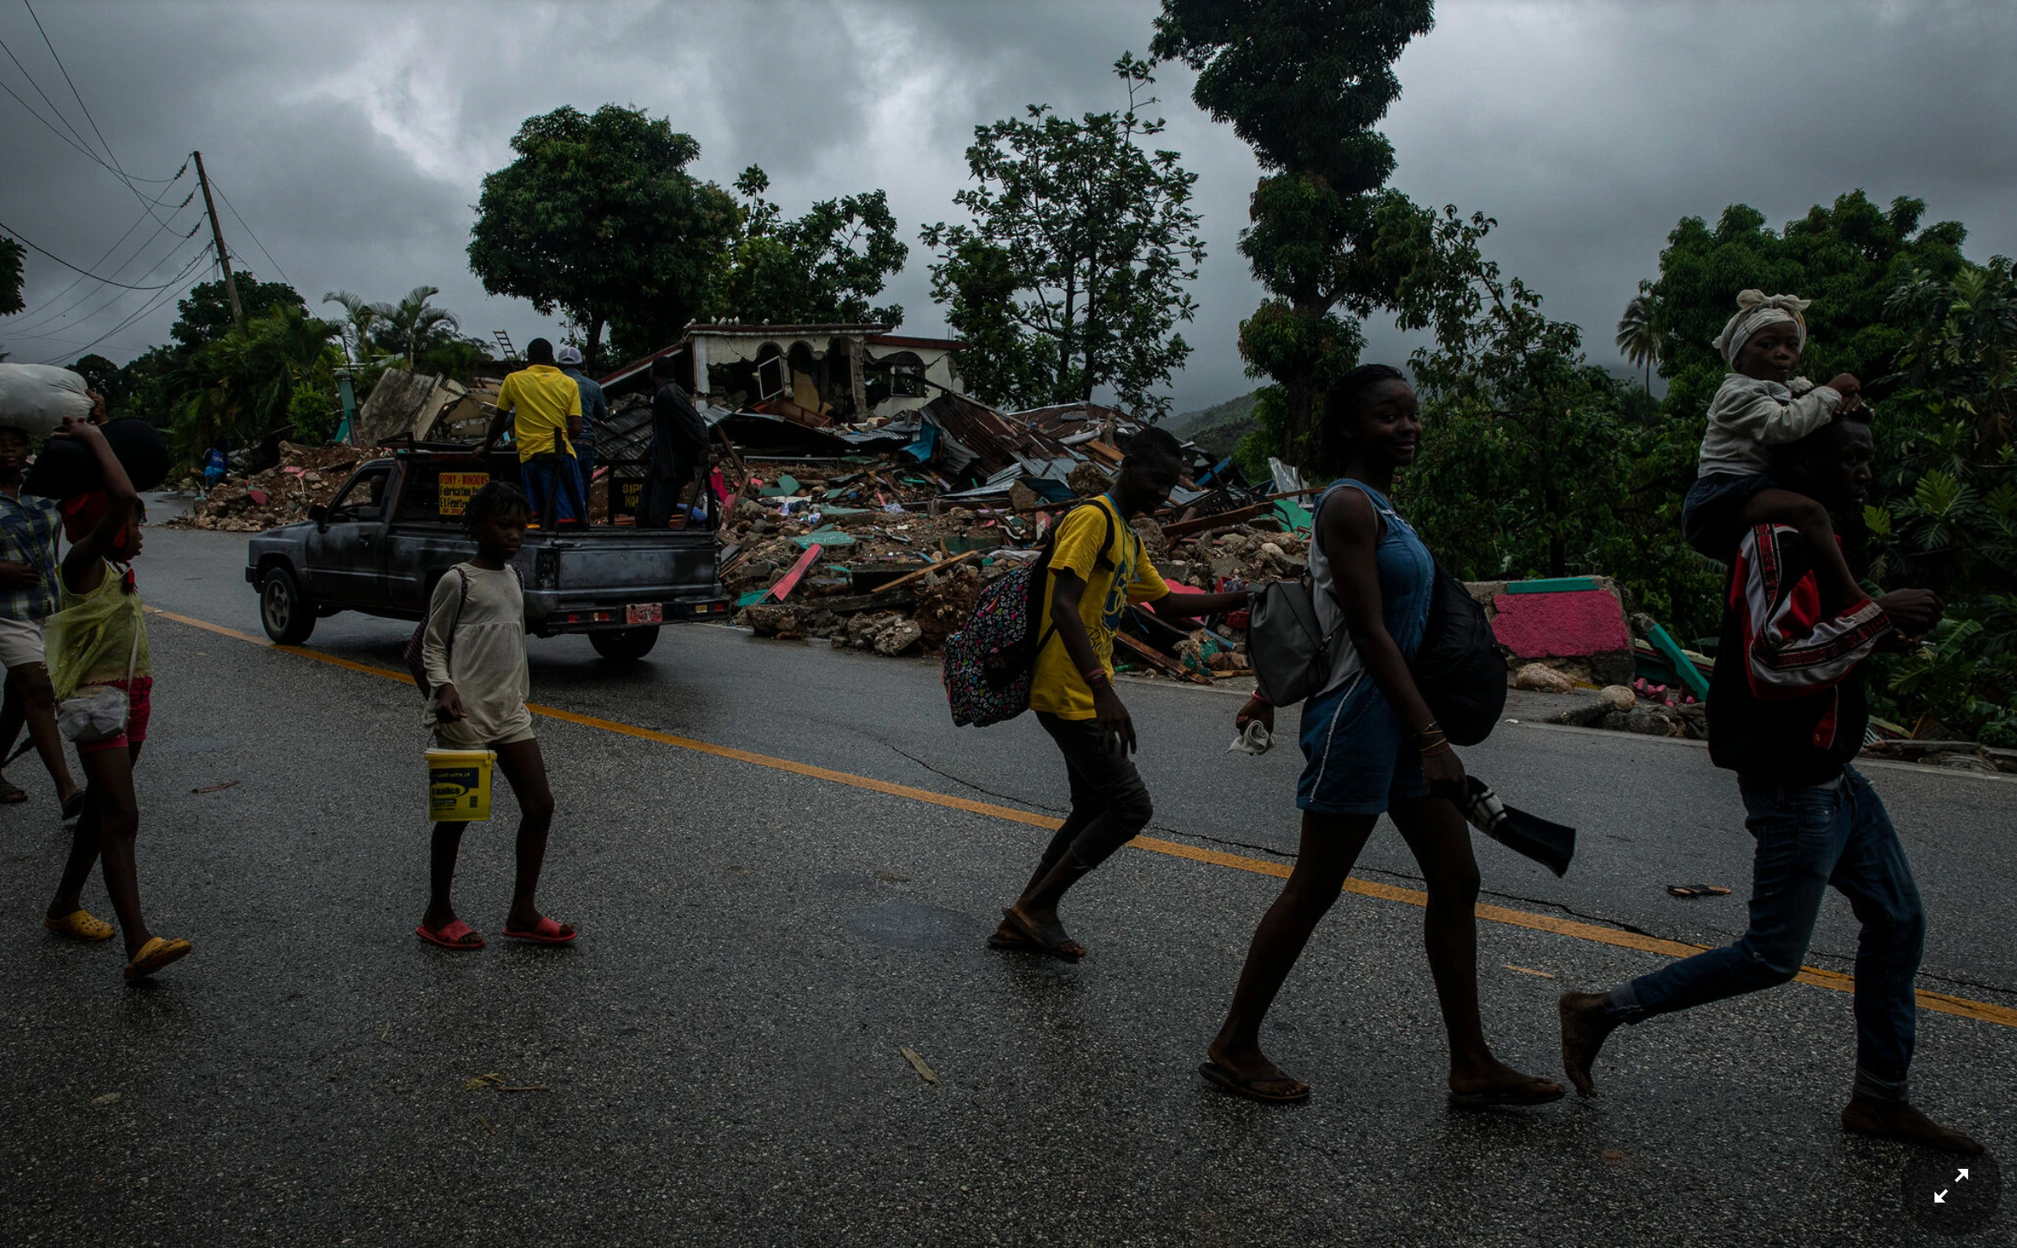

Slide 3
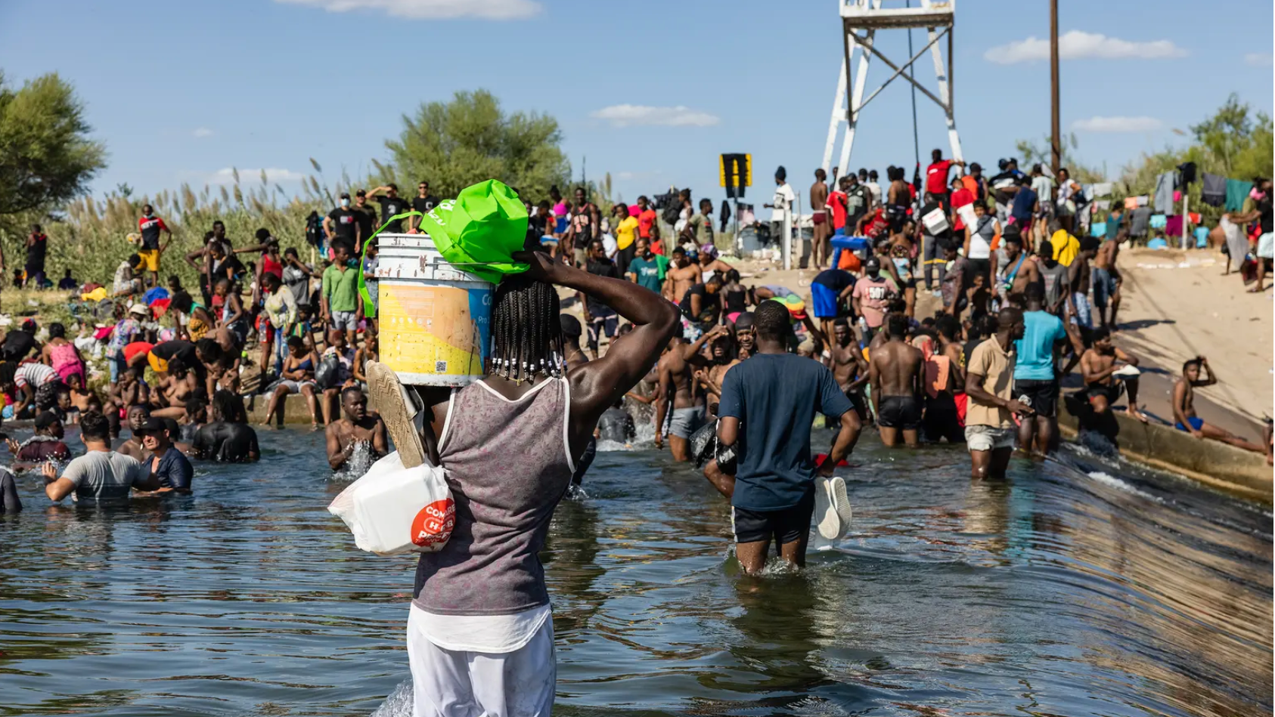

Slide 4
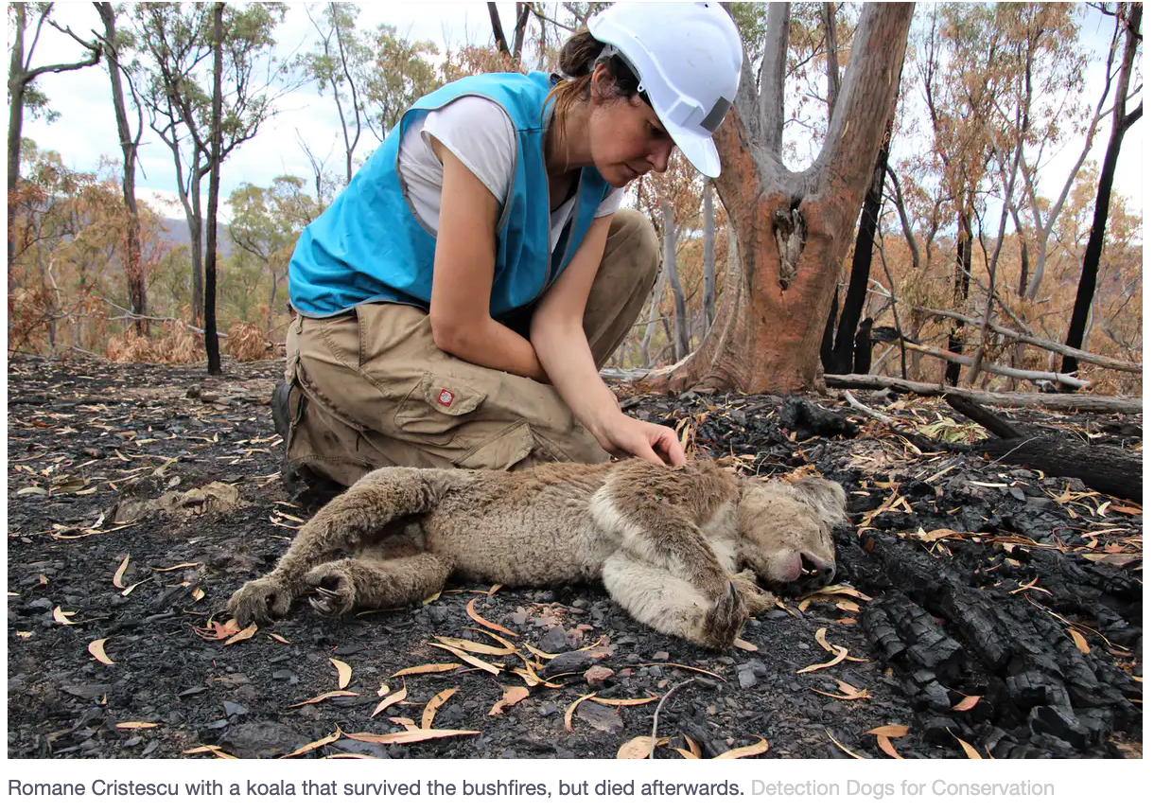

Slide 5
“Something is dreadfully wrong with our world. An earthquake kills hundreds in Peru. A pancreatic cancer patient suffers prolonged, excruciating pain and dies. A pit bull attacks a two-year-old child, angrily ripping his flesh and killing him. Countless multitudes suffer the ravages of war in Somalia. A crazed cult leader pushes eighty-five people to their deaths in Waco, Texas. Millions starve and die in North Korea as famine ravages the land. Horrible things of all kinds happen in our world—and that has been the story since the dawn of civilization.”
-Michael Peterson, God and Evil; An Introduction to the Issues

Slide 6
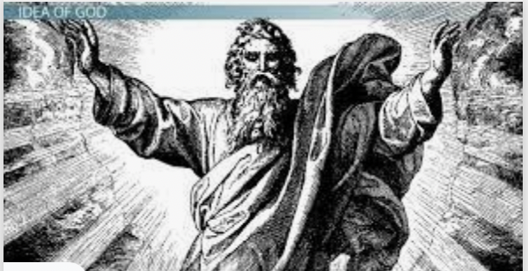
God:
Benevolent
Omnipotent
Omniscient

Slide 7
THE ARGUMENT FROM EVIL
‘Unnecessary suffering’ =(df) suffering that is not justified as an inevitable consequence of pursuing some greater good.
P1: If God exists, God is omnipotent, omniscient and perfectly good.
P2: Any perfectly being would prevent unnecessary suffering if she knew about it, and was able to prevent it.
P3: Any omnipotent and omniscient being would know about, and be able to prevent, any unnecessary suffering there might be.
C1: Therefore, if God exists, there is no unnecessary suffering.
P4: But there is unnecessary suffering.
C2: Therefore, God does not exist.

Slide 8
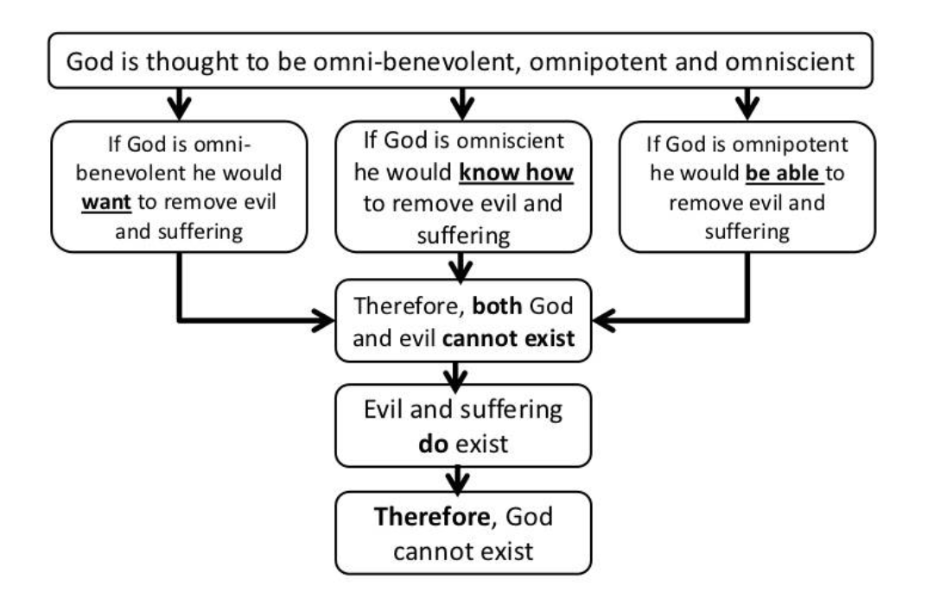

Slide 9
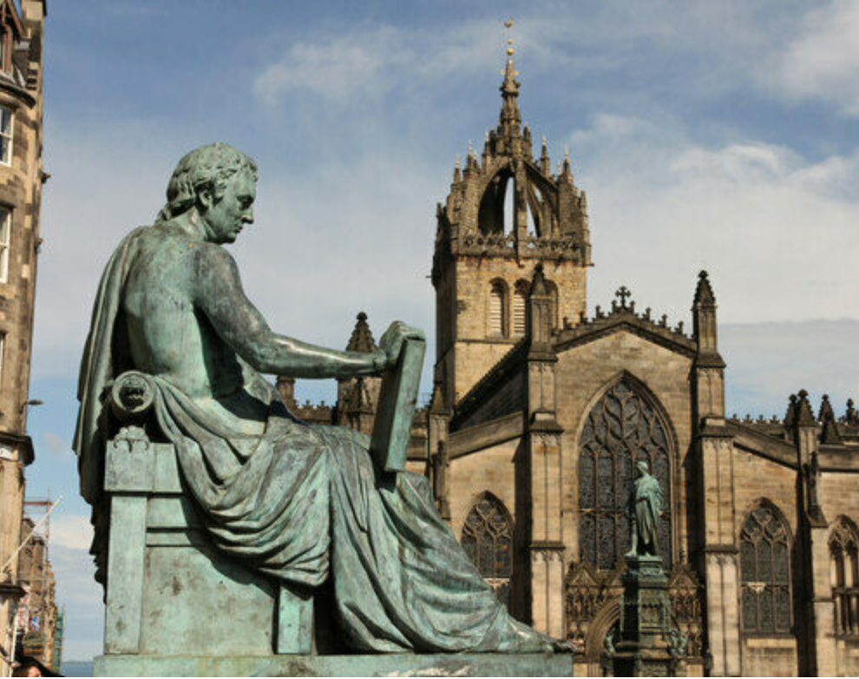
“Is [God] able, but not willing? Then he is malevolent. Is he willing, but not able? Then he is impotent. Is he both able and willing? Whence then, is evil?”
Hume, paraphrasing Epicurus

Slide 10
Logical form of the argument: Suffering is logically incompatible with the existence of God.
NB: Antony rejects this form of the argument; suffering is not incompatible with the existence of God, only unnecessary suffering is. The question is whether there is unnecessary suffering. Does God have good reason to allow suffering?
Evidential form of the argument: The existence of suffering is evidence against the existence of God.

Slide 11
IS EVIL ALL-THINGS-CONSIDERED BEST?
Response on behalf of the theist: God works in mysterious ways. Oftentimes, suffering produces good outcomes- outcomes that are better than those that would have obtained if there had been no suffering.
There is no unnecessary suffering.
Eg. Parent allows child to experience natural consequences of their action. This causes Child suffering, but teaches them an important lesson.

Slide 12
Why can’t we learn these lessons without suffering? Isn’t God omniscient?

Slide 13
THE FREE WILL DEFENSE
God allows suffering because:
It’s good for human beings to possess free will
If we are to possess free will, God cannot prevent us from making bad choices and harming others.
Note: if it works, this defense only works against human-caused suffering; it does not explain why God allows suffering due to natural causes.

Slide 14
“Why, then, did God give them free will? Because free will, though it makes evil possible, is also the only thing that makes possible any love or goodness or joy worth having. A world of automata—of creatures that worked like machines—would hardly be worth creating. The happiness which God designs for His higher creatures is the happiness of being freely, voluntarily united to Him and to each other…. And for that they must be free. Of course, God knew what would happen if they used their freedom the wrong way: apparently He thought it worth the risk.”
-C.S. Lewis

Slide 15
LIMITED OMNIPOTENCE?
Can God create a round square?
Can God make 2+2=5?
Can he make a rock so big he can’t lift it?
Suppose god can’t do the logically impossible.
Then perhaps God is not able to make significantly free creatures and to causally determine that they will always choose what is right and avoid what is wrong.

